Slide 1
RIGOL DL 3021
Departamento de Ingeniería Eléctrica y Electrónica

Slide 2
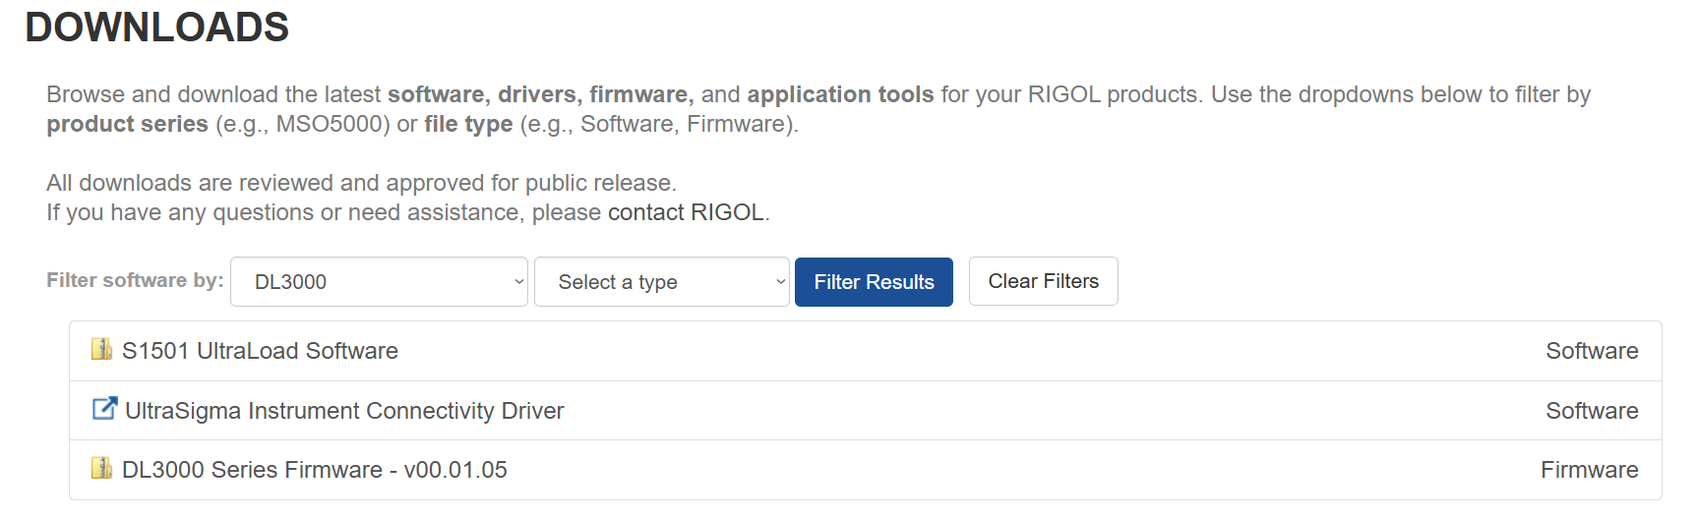
Install Ultra Sigma (PC) Software
  Install UltraSigma Instrument Connectivity Driver
  Execute setup.exe
  It might ask you to install .NET Framework 3.5. If this installation is not successful, execute dotnetfx.exe
  Install S1501 UltraLoad Software and execute Ultraload.exe

Slide 3
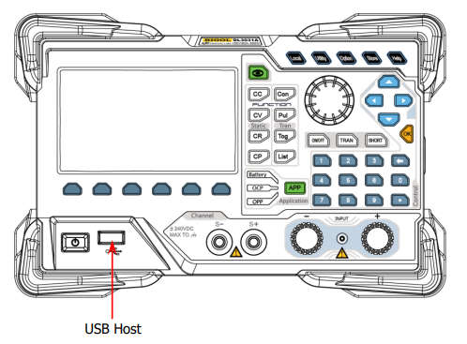
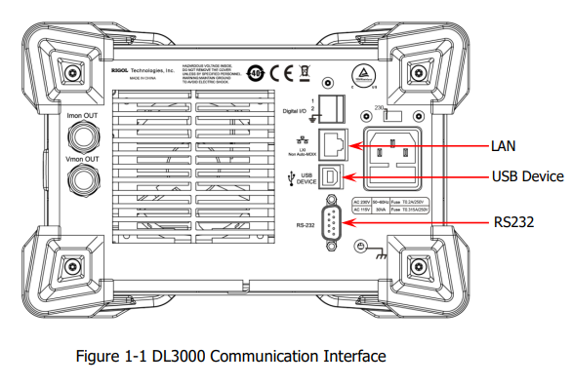
2) Connect the electronic load to the PC and configure the interface parameters for the load. Use one of the following interfaces:
LAN: Use ethernet cable and connect it to your PC or to a router. License Not Supported for DL 3021, only option for ARM64 processors: MAC, Linux, etc..
USB Device: Best option.
RS232: Uses a DB 9 Male-Female cable + USB-RS232 adapter (too expensive)

Slide 4
3) After the load is properly connected to the PC, connect the load to power source and turn it on. In this case, "Found New Hardware Wizard" dialog box appears on the PC. Please install "USB Test and Measurement Device (IVI)" according to the instructions.
4) Programming Instances: you can program DL3000 series with SCPI commands based on NI-VISA in:
Excel
MATLAB
LabVIEW
Visual C++
Visual C#.
Python (install pyvisa and pyvisa-py)
To test that your PC recognizes the Load the first step in all programing instances is sending the *IDN? command and reading the instrument information.

